Slide 1

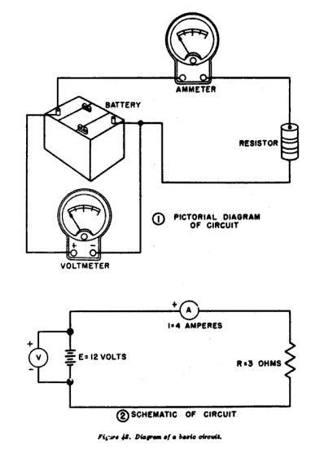
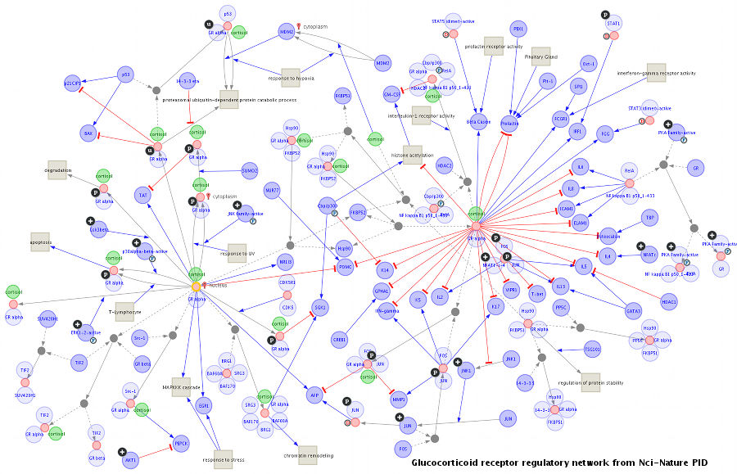
Introduction to mathematical modelling for biology and more

Slide 2
Questions for mathematical models
How will cancer burden change if we apply therapy?
What is the best experimental protocol to measure mutations?
Should we order another national lockdown?
How much money will I have in 5 years?
What will the weather be like tomorrow?

Slide 3
Building block of a mathematical model
Quantities we want to model
Bacteria, infected people, cancer cells, population
Facebook likes, savings, neutrons
Events that change these quantities
Division, death, immigration
Predation, merge, chemical reaction, interest paid
Rates at which events happen
Every year, every X minutes
20% of the population, every third molecule

Slide 4
Example: growth of a bacterial population
Escherichia coli is a gram-negative, facultative anaerobic, rod-shaped, coliform bacterium of the genus Escherichia that is commonly found in the lower intestine of warm-blooded organisms. Optimum growth of E. coli occurs at 37 °C (99 °F), but some laboratory strains can multiply at temperatures up to 49 °C (120 °F). E. coli grows in a variety of defined laboratory media, such as lysogeny broth, or any medium that contains glucose, ammonium phosphate monobasic, sodium chloride, magnesium sulfate, potassium phosphate dibasic, and water. Under favourable conditions, it takes as little as 20 minutes to reproduce.

Slide 5
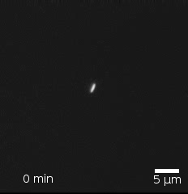
Example: growth of a bacterial population
Escherichia coli bacteria are growing in a contaminated sample. We assume they have plenty of nutrients and are under optimal conditions. Each bacterium divides every 20 minutes (and becomes two bacteria).

Slide 6
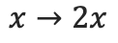
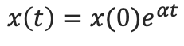
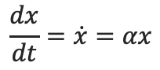
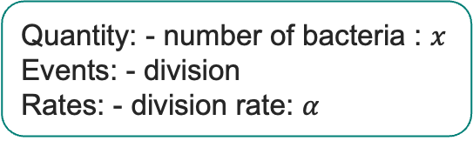
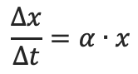
Example: growth of a bacterial population
Escherichia coli bacteria are growing in a contaminated sample. We assume they have plenty of nutrients and are under optimal conditions. Each bacterium divides every 20 minutes (and becomes two bacteria).
Quantity: - number of bacteria : $x$
Events: - division
Rates: - division rate: $α$
$$x→2x$$
$$\frac{Δx}{Δt}=α∙x$$
$$\frac{dx}{dt}=\dot{x}=αx$$
$$x\left(t\right)=x(0)e^{αt}$$

Slide 7
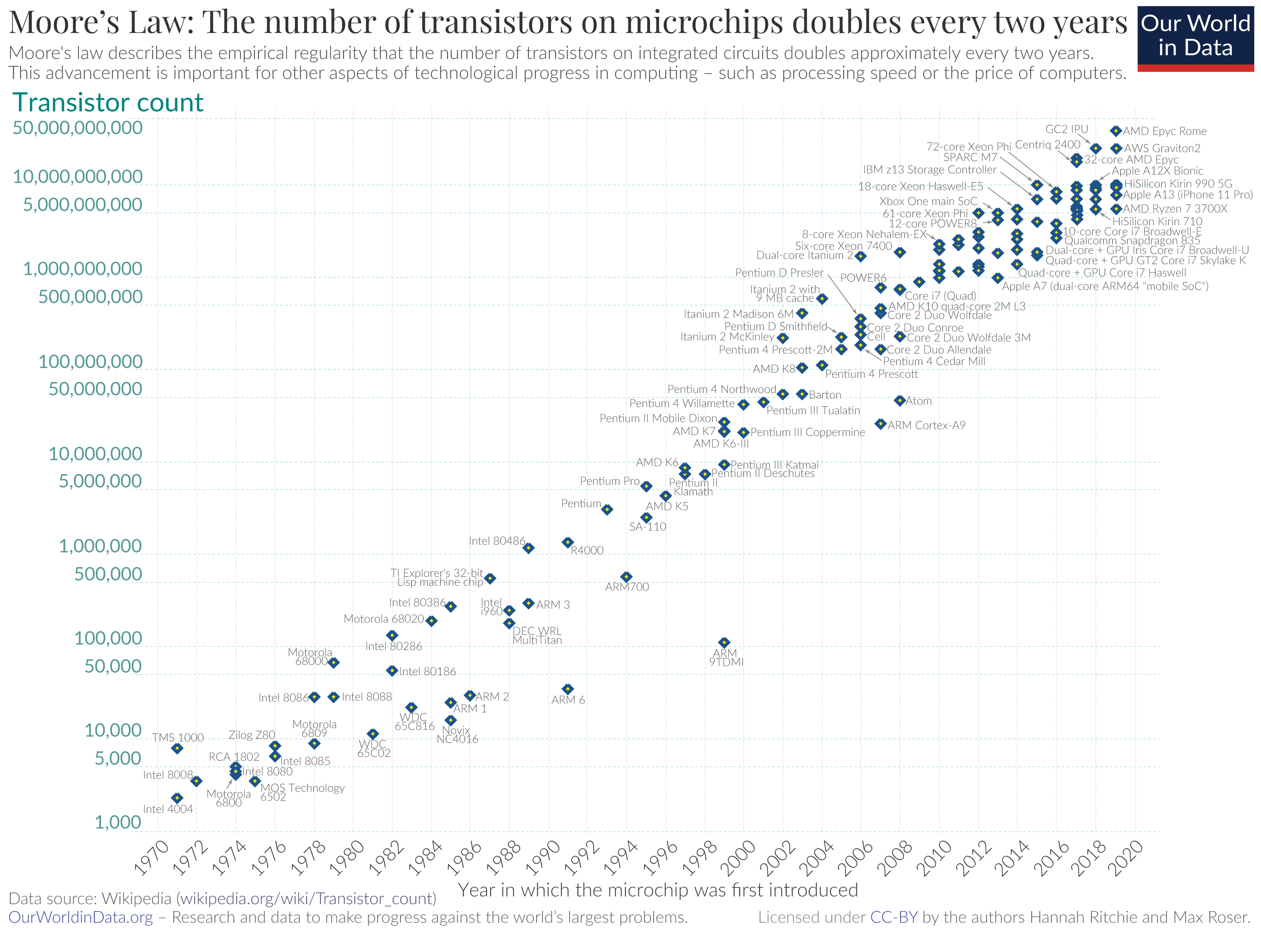
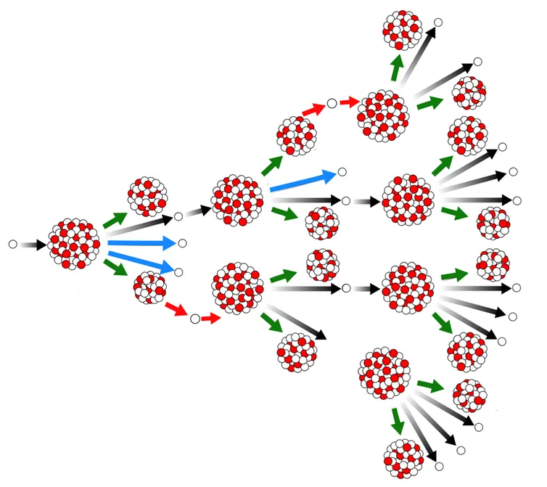
Exponential growth
Other examples of exponential growth?
Compound interest
Nuclear chain reaction
Moore’s law
Spread of infection
What are we missing?

Slide 8
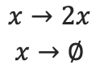
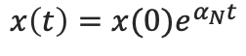
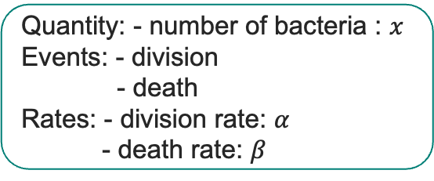
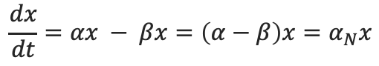
Exponential growth with death
Escherichia coli bacteria are growing in a contaminated sample. We assume they have plenty of nutrients and are under optimal conditions. Each bacterium divides every 20 minutes (and becomes two bacteria).
In the same time-frame, on average every 5th bacterium dies.
Quantity: - number of bacteria : $x$
Events: - division
- death
Rates: - division rate: $α$
- death rate: $β$
$$x→2x$$
$$x→∅$$
$$x\left(t\right)=x(0)e^{α_{N}t}$$
$$\frac{dx}{dt}=αx − βx=\left(α−β\right)x=α_{N}x$$

Slide 9
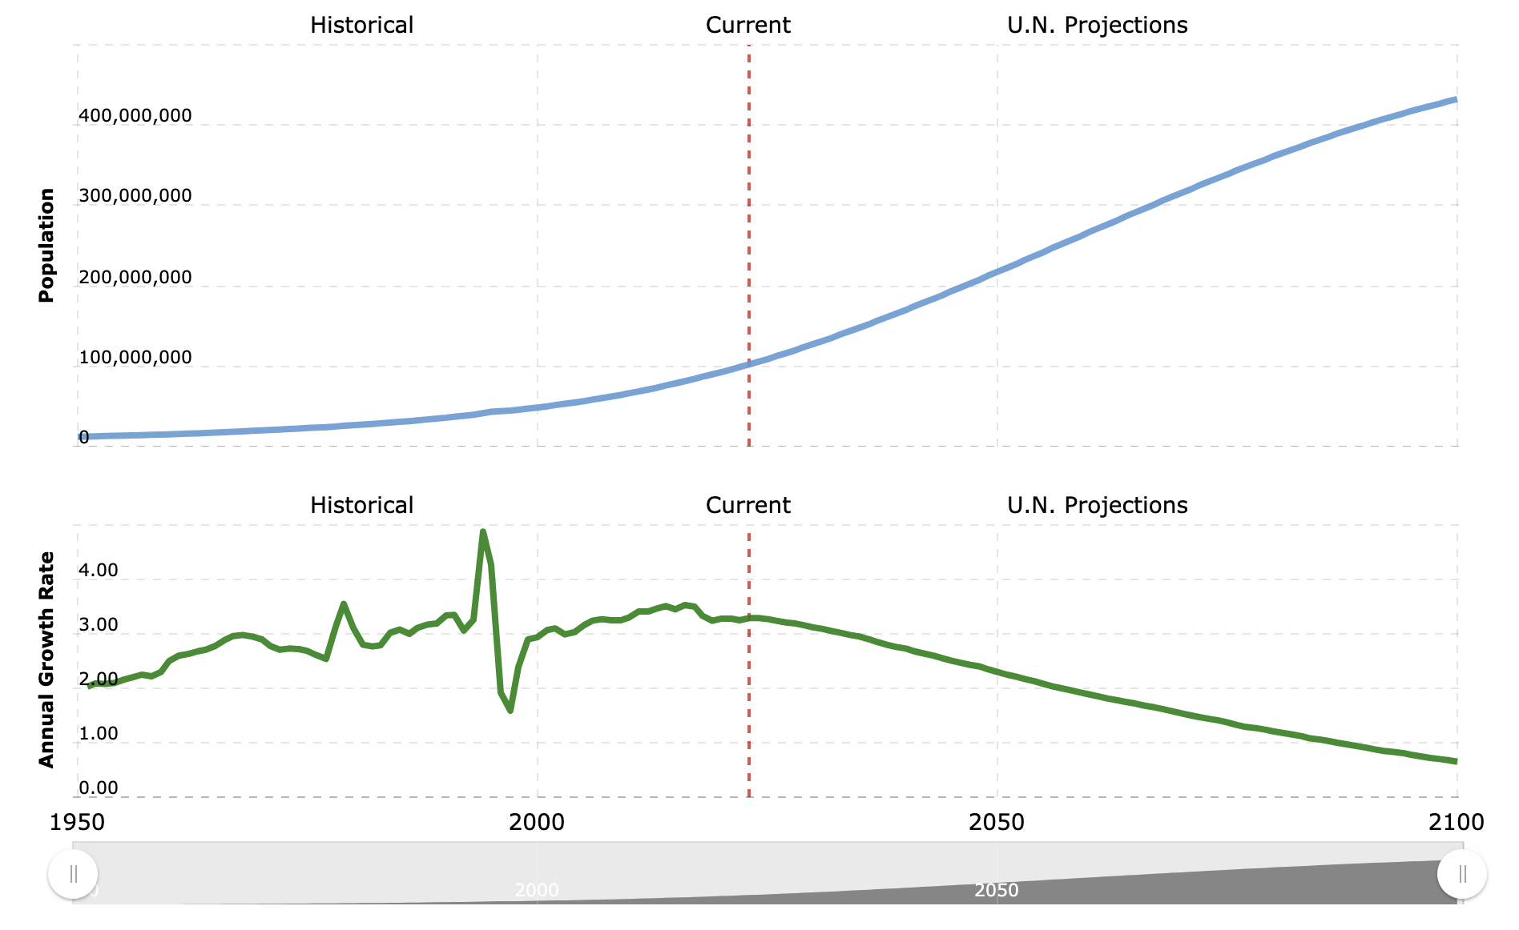
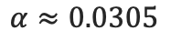
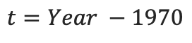
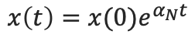
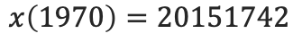
Example: population of DRC
$$x\left(t\right)=x(0)e^{α_{N}t}$$
$$t=Year −1970$$
$$x\left(1970\right)=20151742$$
$$α≈0.0305$$

Slide 10
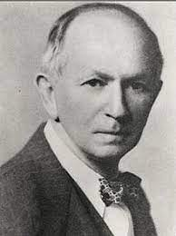
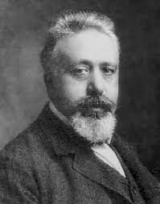
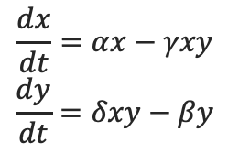
Example: predator-prey model
in Canadian northern forests the populations of the lynx and the snowshoe hare are intertwined in a life and death struggle.
How does this model represent the populations?
What are the species, events, assumptions in this model?
$$\frac{dx}{dt}=αx−γxy$$
$$\frac{dy}{dt}=δxy−βy$$

Slide 11
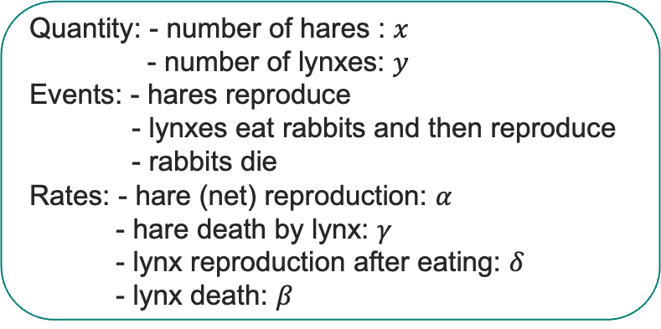
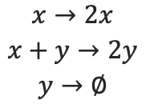
Example: predator-prey model
in Canadian northern forests the populations of the lynx and the snowshoe hare are intertwined in a life and death struggle.
Quantity: - number of hares : $x$
- number of lynxes: $y$
Events: - hares reproduce
- lynxes eat rabbits and then reproduce
- rabbits die
Rates: - hare (net) reproduction: $α$
- hare death by lynx: $γ$
- lynx reproduction after eating: $δ$
- lynx death: $β$
$$x→2x$$
$$x+y→2y$$
$$y→∅$$
$$\frac{dx}{dt}=αx−γxy$$
$$\frac{dy}{dt}=δxy−βy$$

